Slide 1
Problems using ‘curly arrows’

Slide 2
DEFINITION
“Curly arrows are the notation used by organic chemists to indicate the movement of electrons when bonds are made, broken, or moved.
A ‘curly arrow’ represents the movement of an electron pair from its original position to a new one. The tail of the arrow shows where the electron pair has come from, and the head of the arrow shows where the electron pair is going to.”
Royal Society of Chemistry

Slide 3
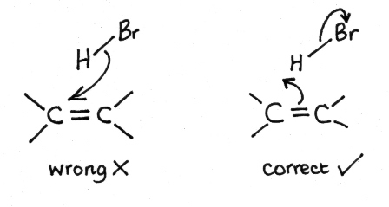
Common errors made by students
Showing the arrow the wrong way round.
Typically when showing the electrophilic addition reaction of H—Br with an alkene the arrow comes from the H—Br to the alkene – not the other way round.

Slide 4
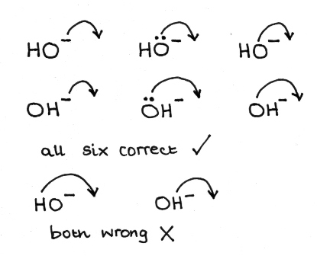
2.Starting the arrow in the wrong place.
This is often seen when the hydroxide ion is used a nucleophile in a nucleophilic substitution reaction with a halogenoalkanes. The arrow must start either from the negative charge on the hydroxide ion or even better from a non-bonding pair of electrons on the hydroxide ion. It will be penalised if it is shown originating from the hydrogen atom.

Slide 5
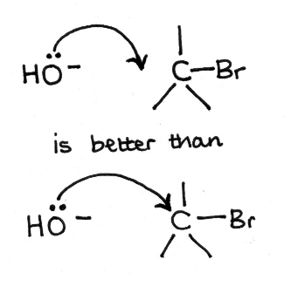
3. Finishing the arrow in the wrong place.
There is some disagreement with some examiners who have been brought up to draw the arrow going directly to the carbon atom in a nucleophilic substitution reaction. From the definition the arrow should end up where the bond will be formed which will be between the carbon atom and the HO– group when it is bonded.

Slide 6
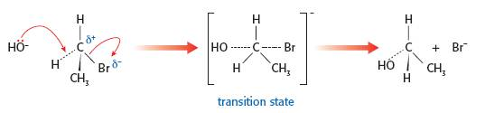
The best way to show the mechanism for bimolecular nucleophilic substitution reactions.

